Slide 1
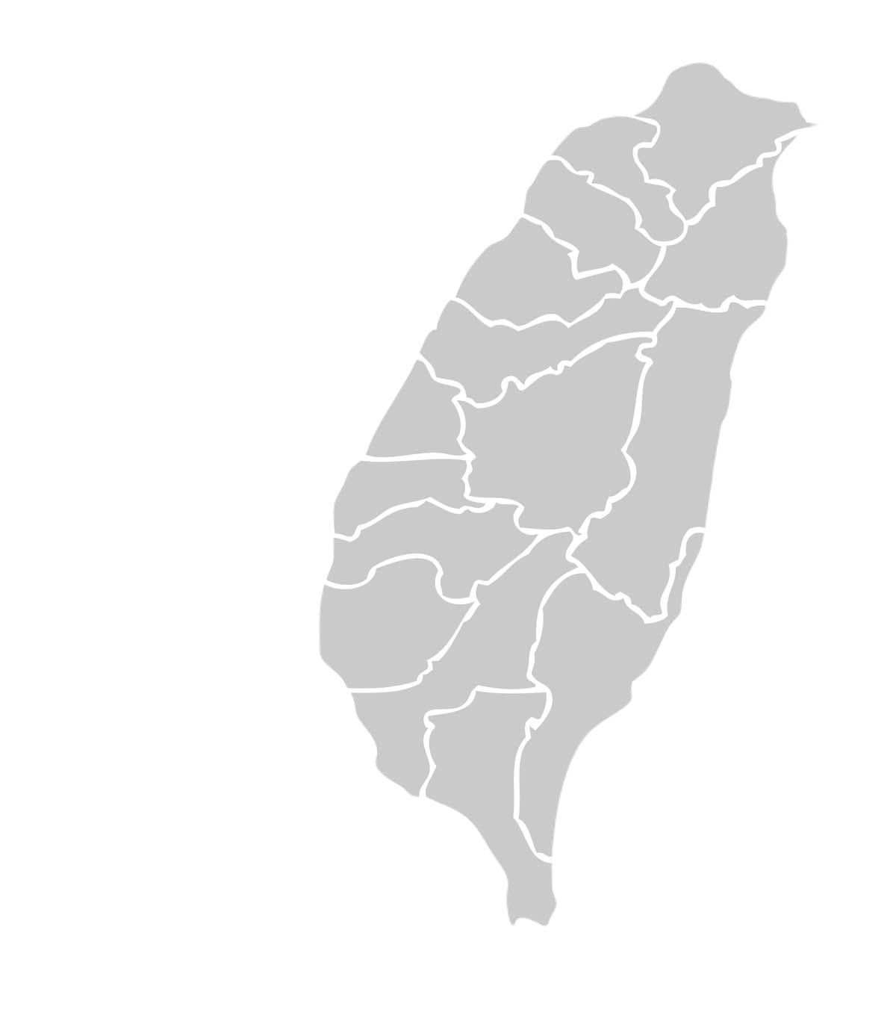
Taiwan
National
Changhua
University of
Education.

